Slide 1

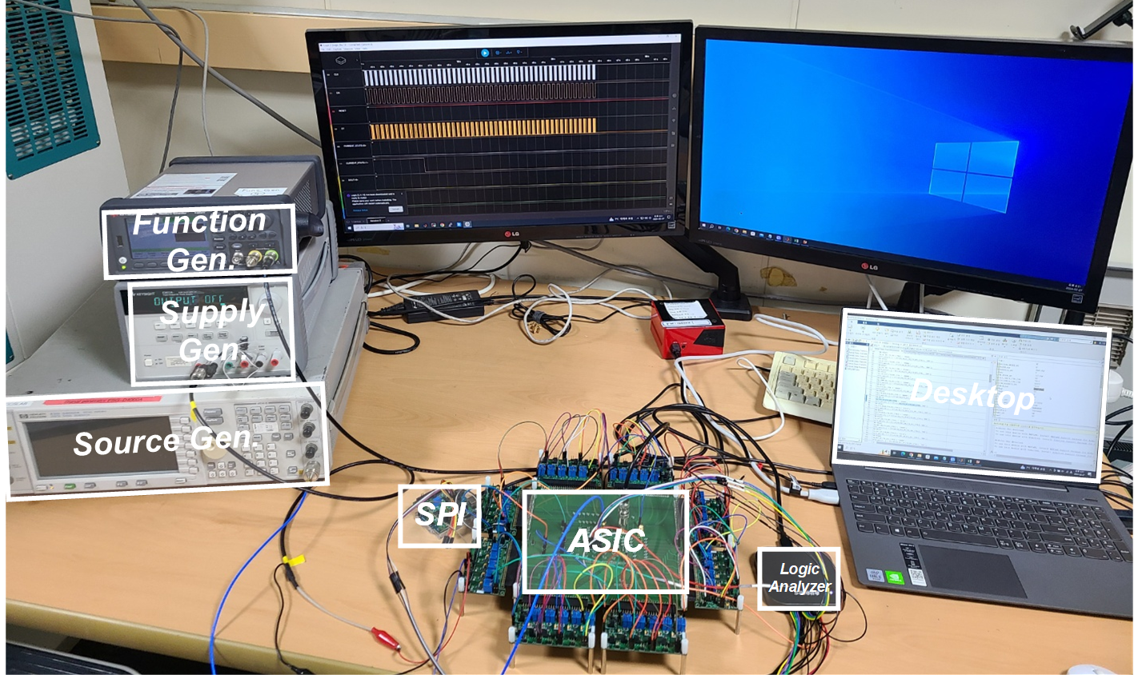
A Personalized Keyword Spotting Processor with High
Accuracy for 35 Classes
Hyuk-Jin Lee, Donghwan-Kim, Gi-Woo Lee and SeongHwan Cho
The School of Electrical Engineering of KAIST, Daejeon, Korea
Introduction
Personalized Training only the last layer
Conventional Keyword Spotting Processor
  To ensure high linearity and resolution in the analog front-end, significant area and power consumption are inevitable.
  The use of FFT for feature extraction demands considerable area and power.
  Neural networks demand substantial memory and computation.
  Training the last layer speeds up
  learning and achieves high accuracy
  with minimal data.
  Smaller input features in the last layer
  also reduce memory size.
Block diagram of Conventional Keyword Spotting Processor
Personalized Incremental Learning
Proposed Keyword Spotting Processor
  Incremental learning involves integrating new data while preserving
  knowledge learned from past experiences.
  Maintain high accuracy by using a personalized KWS network.
  Replace the FFT-based feature extractor with convolution layers.
Block diagram of Proposed Keyword Spotting Processor
Contributions and Scope of the Work
Chip Photo & Comparison Table
Personalized Training
Convolution layer based Feature Extractor
Implemented with Samsung 28nm Technology(SS28-2301)
Achieving high accuracy with a small number of parameters
Reducing area and computational load
On-Chip SRAM | 13kB
Supply Voltage | 0.6V-0.8V
Frequency | 1MHz
Power | 3.1uW
Over 94% accuracy with fewer than 9k parameters
Only 0.005mm² of area overhead for FE
KWS Model & Overall Architecture
Overall Architecture and Timing Diagram
Chip Photo
  16 4-bit MAC operators are used for both FE conv operations and NN conv operations.
  One 8-bit MAC operator is used for inference in fully connected layer operations.
Measurement Set-up
 | 2020 ISSCC | 2020 JSSC | 2021 ISSCC | 2021 JSSC | 2022 ISSCC | This work
Process | 28nm | 65nm | 180nm | 65nm | 65nm | 28nm
# of keywords | 2 | 12 | 1 | 7 | 12 | 35
Power | 510nW | 10.6uW | 148nW | 11mW | 23uW | 3.1uW
Accuracy | 94.6% | 90.9% | 94% | 90.4% | 86% | 94%
Accent speech recognition | ^{x} | ^{x} | ^{x} | ^{x} | ^{x} | º
Overall Architecture
Comparison Table
Acknowledgement
Timing Diagram
The chip fabrication and EDA tool were supported by the IC Design Education Center(IDEC), Korea.

