Slide 1

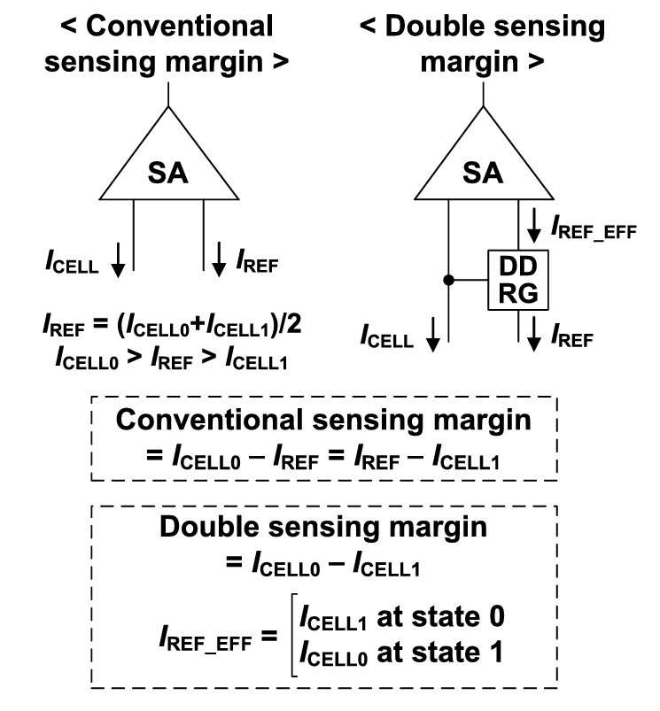
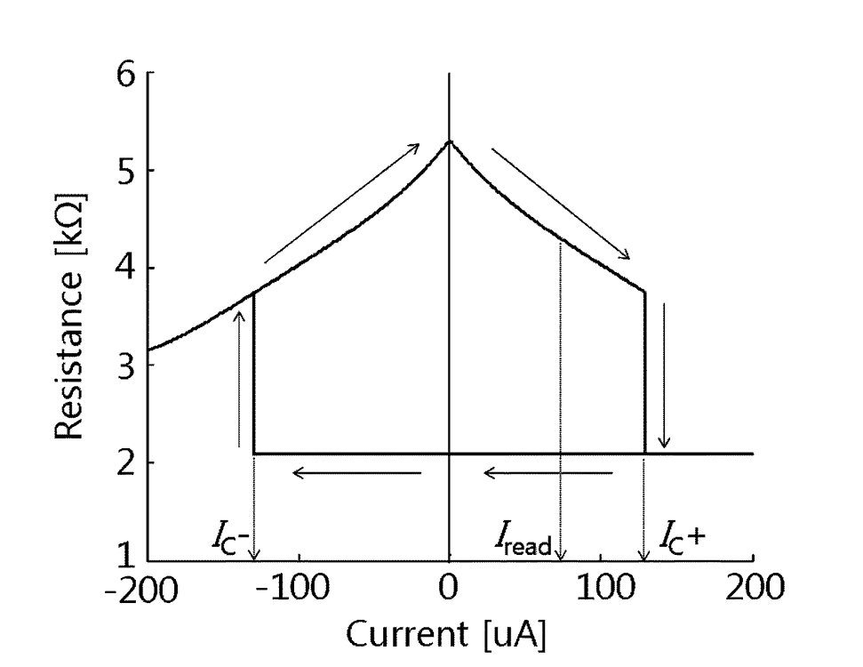
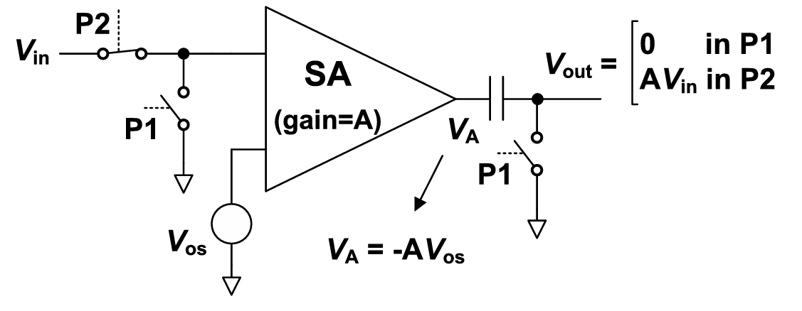
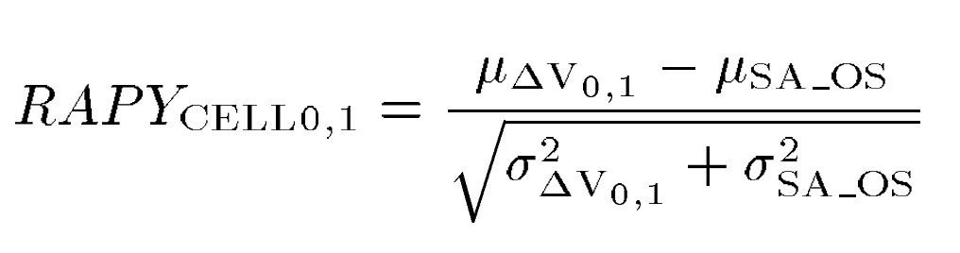
Reliability Enhanced Offset-Canceling Current-Sampling Sense Amplifier for STT-MRAM
Jaehwan Kim and Taehui Na
Department of Electronics Engineering, Incheon National University, Incheon 22012, South Korea
Introduction
Preliminary
Read access pass yield in sigma for a single cell
Offset voltage cancellation
R-I curve of MTJ model
Double sensing margin structure
MTJ (Magnetic Tunnel Junction): When the magnetic moments are parallel, the resistance is low, and when antiparallel, the resistance is high, expressed as Tunnel Magnetoresistance (TMR).
RAPY (read access pass yield in sigma for a single cell) : Since read access pass occurs when ∆V_{0,1} is greater than V_{SA_OS}, read access pass yield in sigma for a single cell with state0 or state1 (RAPY_{CELL0} or RAPY_{CELL1}) can be obtained by combining distribution of V_{SA_OS} and ∆V_{0,1}.
Offset voltage cancellation is usually done through an open loop with two-phase sensing operations. Additionally, a double sensing margin structure has been developed to address sensing margin issues by generating a variable reference signal based on the data bit-cell state, effectively doubling the sensing margin.
Proposed circuit
RE-OCCS consists of a power supply (V_{DD}), source degeneration pMOS transistors (M7, M8), load pMOS transistors (M1, M2), PRE signal switches (M9, M10, M11, M14), first stage SA output voltage storage and capacitive coupling capacitor pMOSCAP (M5, M6), clamp nMOS transistors (M3, M4), and AMP signal switches (M12, M13).
In Phase 1 (P1), the PRE signal switch is turned on and the AMP signal switch is turned off to sample the current.
In Phase 2 (P2), the ΔV is sufficiently amplified before the strong positive feedback stage. Both the PRE signal and AMP signal are turned off during this phase to amplify ΔV. This addition of P2 is the distinguishing feature of the proposed reliability-enhanced OCCS-SA compared to the conventional OCCS-SA.
In Phase 3 (P3), the PRE signal is turned off and the AMP signal is turned on, enabling the strong positive feedback effect to further amplify ΔV, driving it close to the rail-to-rail voltage.
P1 : Current sampling
S1-S4 ON, DS1, DS2 OFF
P2 : ∆V pre-amplification
S1-S4 OFF, DS1, DS2 OFF
P3 : ∆V amplification
S1-S4 OFF, DS1, DS2 ON
RE-OCCS
Simulated waveform
Simulation results
Chip operation failure
Yield comparison based on TMR
Simulation condition
R_{L} = 3K
-45°C / 90°C / TT corner
I_{READ} = 20μA
Monte Carlo 10000 times
MTJ variation 4%
RAPY comparison based on MTJ variation
Simulation condition
R_{L} = 3K, R_{H} = 6K (TMR = 100%)
-45/90°C/TT corner
I_{READ} = 20μA
Monte Carlo 10000 times
As illustrated in the figure, the read-related signal was not transmitted to the SA array.
Conclusion
Simulation results demonstrated that the RE-OCCS clearly outperformed both OCCS and SDSC. However, issues arose during the chip fabrication process. The chip malfunctioned due to the read enable signal generated by the signal generator being directly connected to the PAD without passing through a buffer. As a result, the read enable signal was not properly transmitted to the SA array.

