Slide 1

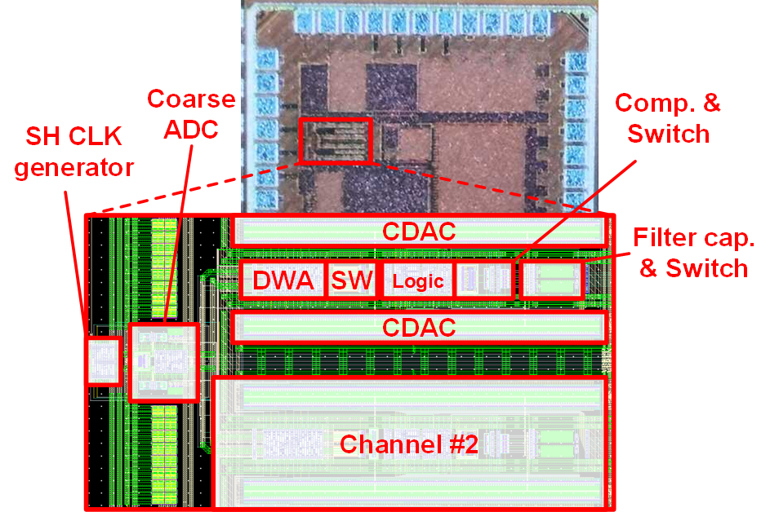
50MHz-BW 168.8dB-FoM 2x Time-interleaved Bandpass Noise Shaping SAR ADC Using Passive Filter Seungjun Song and Hyungil Chae Konkuk University
Bandpass analog-to-digital converters (BP ADCs) are one of the main building blocks used to simplify RF receivers by directly digitizing IF signals. The CT structures have high power consumption, and the DT structures have low bandwidth(BW) performance. For effective time interleaving by maximizing the speed and BW of a single channel, this work proposes a TI BP NS-SAR ADC consisting of two 1st-order HP ADC channels.
Block diagram of proposed BP ADC and NTF plot |  |  | Operation of HP NS-SAR for single channel and circuit implementation of TI BP NS-SAR ADC
Enhanced loop filter due to adjusted NTF coefficients In-band noise reduction 20% reduction in loop-filter capacitor(0.2C_{DAC}) → Area reduction and charge sharing speed improvement still stable with a margin |  |  | 5-step behavior of a single channel Residual voltage generation after the (K-1)th conversion Filtered voltage generation by residual voltage charge-sharing Sampling Conversion preparation with passive gain Conversion |  |  | Circuit implementation Coarse-fine structure DWA : reduced CDAC mismatch Redundant bit : eliminate coarse-to-fine mismatch(64C) and settling error(4C) Decimation filter : based on quadrature sampling
Test setup, die photo, and measured PSD |  |  |  |  | Comparison table and energy efficiency comparison
Process : 28nm CMOS Supply voltage : 0.9V Active area : 0.026mm² | (top middle) Single Channel HP ADC output (top right) BP ADC raw output (bottom middle) Zooming in on the in-band (bottom right) BP ADC decimated output SNDR : 63.8dB(raw, 200M) / 64.2dB(decimated, 400M) Performance limitation : mismatched tone at Fs/4. Calibration : offset calibration and on-chip DWA |  |  |  | (left) Comparison table with recently reported bandpass ADCs Fast sampling speed and widest bandwidth among DT structures Lowest supply voltage Best power efficiency achieved with the lowest power consumption (right) Power efficiency comparison with BP ADCs previously reported in ISSCC and VLSI symposium Showing the best performance
An improved passive loop filter was presented. This improved speed and reduced filter capacitor size by 20%. A single channel 1st order high pass noise shaping SAR ADC was presented. This work shows the best power efficiency among BP ADCs and has the widest bandwidth among DT structures.
[B. Murmann, "ADC Performance Survey 1997-2023"]
The chip fabrication and EDA tool were supported by the IC Design Education Center(IDEC), Korea.

