Slide 1
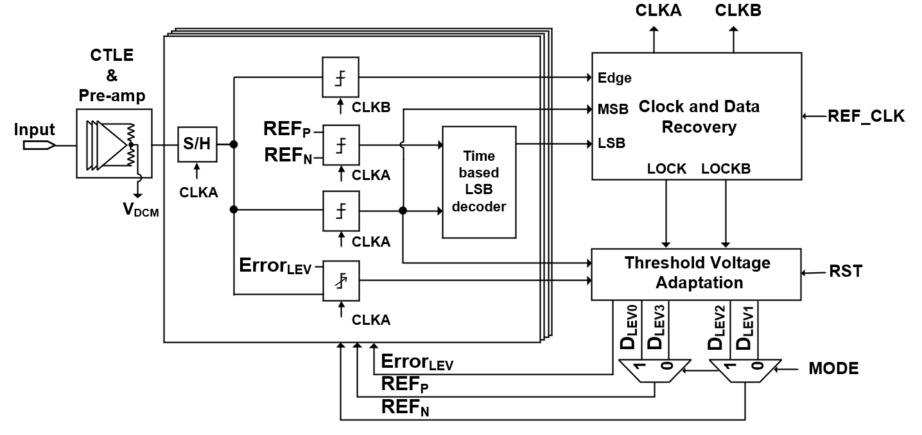
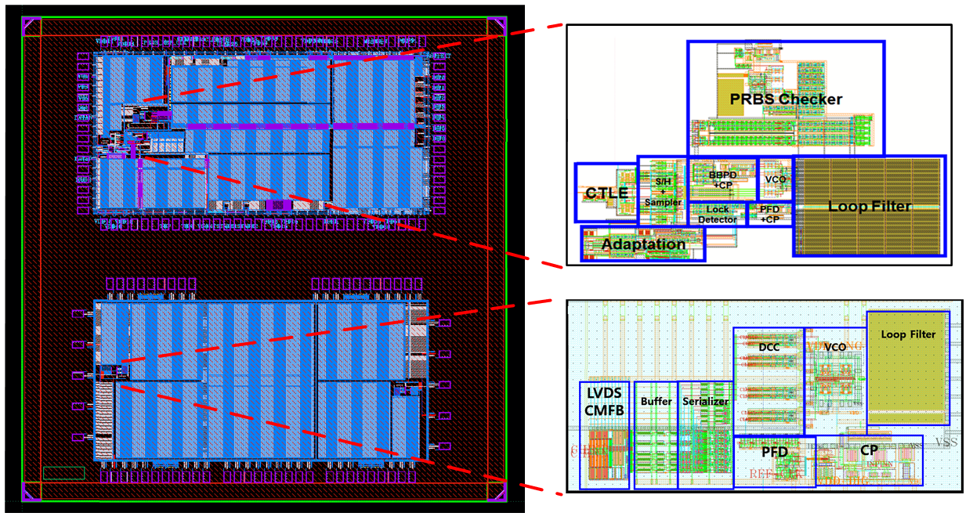
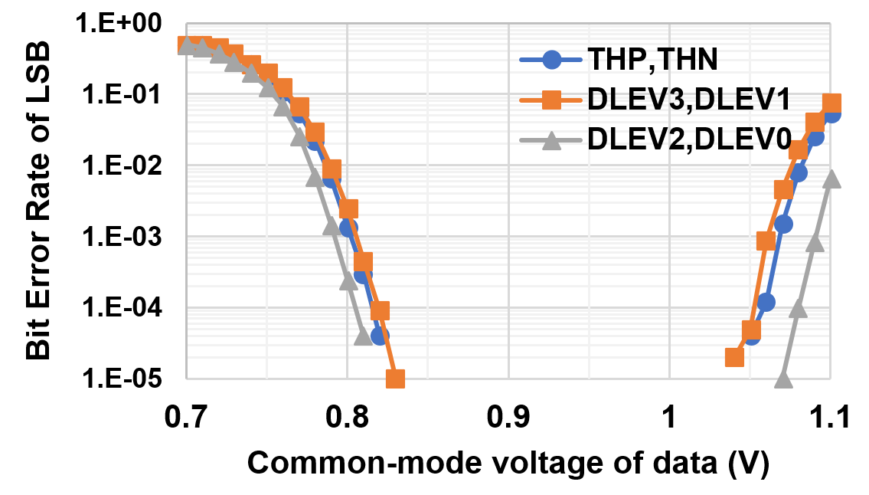
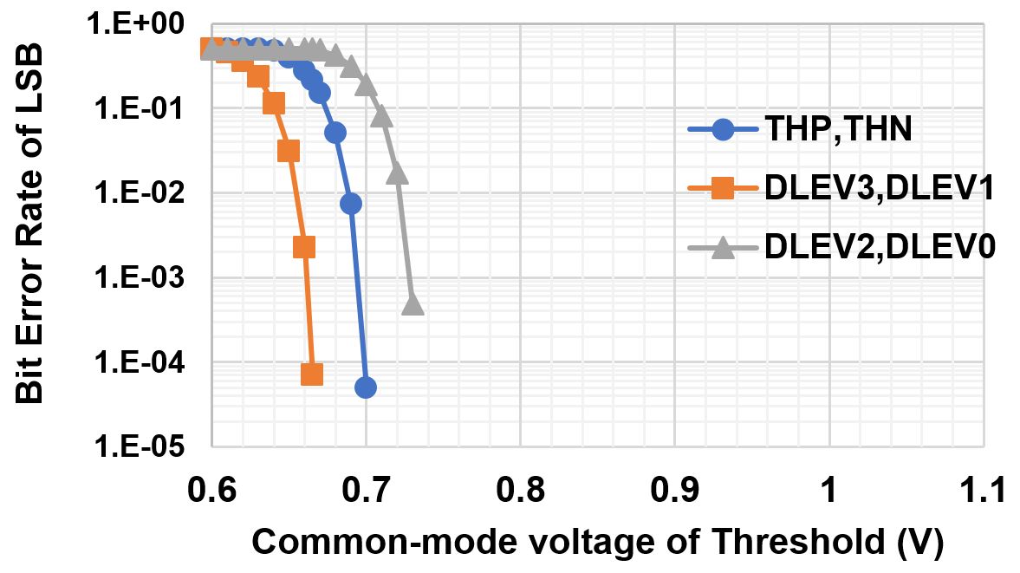
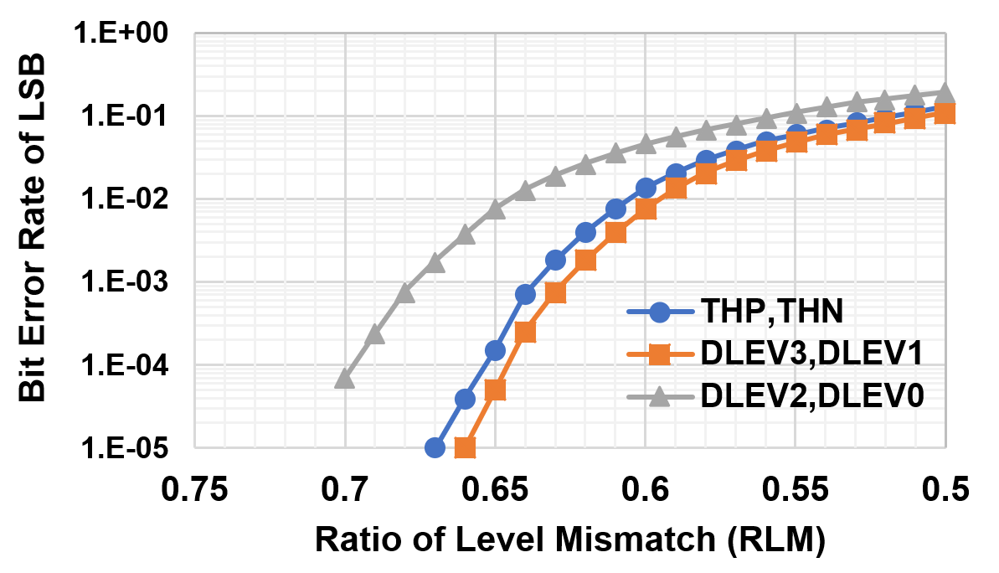
A PAM-4 Receiver with Selective Reference Voltage Adaptation for Strongness to Comparator Voltage Variations
Jeong-Mi Park, Seoung-Geun Cho, and Jin-Ku Kang
Department of Electrical and Computer Eng., Inha University, Incheon, Korea
Introduction
This poster describes a pulse amplitude modulation-4 (PAM-4) receiver with low sensitivity to comparator voltage variation. A time-based LSB decoder is used to decode the PAM-4 data. And it has improved bit error rate (BER) performance by selecting data level as a reference voltage. In addition, a single error sampler is utilized to perform continuous reference voltage adaptation based on random data. By using the data levels as the reference voltage, the adaptation algorithms are simplified by finding only two data levels. So, it can reduce power consumption and hardware complexity. The simulation result shows power consumption of the proposed receiver is only 0.96 [pJ/bit] at 20 Gb/s. And the average adaptation time is only 0.705 μs.
Result and Discussion
The proposed PAM-4 RX receives 20 Gb/s PAM-4 signal. Fig. 1 is a block diagram of the proposed RX. It is composed of continuous time linear equalizer (CTLE), samplers, clock and data recovery (CDR), and reference voltage adaptation. And Fig. 2 is the layout of the proposed idea.
Time-based LSB decoders apply the relationship between the input voltage amplitude and the delay of the sampler to determine the LSB. In proposed idea, by using the data level as the reference voltage, the nonlinearity of the delay is compensated. Using data level selectively can ensure robust performance under the various voltage variations and it can improve BER.
Fig. 3 shows the BER simulation under the voltage variation environment. If proper data level is selected, BER can be improved in any voltage variation environment.
In addition, applying data levels as reference voltage makes adaptation algorithms simplified. This is because the step for finding the center of the data eye isn’t needed. Moreover, the proposed algorithm enables continuous reference voltage adaptation based on random data using only one error sampler.
The simulation result shows power consumption of the proposed receiver is only 0.96 pJ/bit. And the average adaptation time is only 0.705 μs.
Fig. 1. Block diagram of the proposed PAM-4 RX.
Fig. 2. Layout of the proposed RX.
(a)
(b)
(c)
Fig. 3. LSB BER simulation under the voltage variation (a) Fluctuation of the data common mode voltage (b) Fluctuation of the reference common mode voltage (c) RLM distortion.
Conclusion
A 20 Gbps PAM-4 RX is designed and simulated in a 28nm CMOS technology. The circuit is robust by using data level as reference voltage. In addition, continuous reference voltage adaptation based on random data is possible by only using a single sampler.
Acknowledgement
This work was supported by Inha University. CAD tools and chip fabrication were provided by IDEC.

